Slide 1
Backtracking

Slide 2

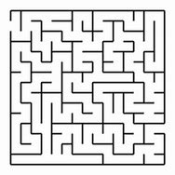

Slide 3
Why backtracking?
systematic examination of the candidate list often results in significant run-time savings in both the worst and expected cases.
eliminate the explicit examination of a large subset of the candidates while still guaranteeing that the answer will be found if the algorithm is run to termination.

Slide 4
Backtracking is a systematic way to search for the solution to a problem.
In backtracking we begin by defining a solution space for the problem.
This space must include at least one (optimal) solution to the problem.
In the case of the rat-in-a-maze problem, we may define the solution space to consist of all paths from the entrance to the exit.
next step is to organize the solution space so that it can be searched easily.
The typical organization is either a graph or a tree.

Slide 6
Represent the solution space- graph or tree

Slide 7
0/1 knapsack tree as a solution space

Slide 8
When the problem we are to solve asks for a subset of n elements that optimizes some function, the solution space tree is called a subset tree.
So the solution space tree for an n-object 0/1 knapsack instance is a subset tree. Such a tree has 2 ^{n} leaf nodes and 2^{n+1} − 1 total nodes. As a result, every algorithm that moves through all nodes in the tree must spend Ω(2^{n}) time.

Slide 9
the solution space, this space is searched in a depth-first
2 types of node: live node and E node
start node is both a live node and the E-node (expansion node).

Slide 10
From this E-node, we try to move to a new node.
The old E-node remains a live node.
If we cannot move to a new node, the current E-node dies (i.e., it is no longer a live node)
we move back (i.e., backtrack) to the most recently seen live node that remains. This live node becomes the new E-node.
The search terminates when we have found the answer or when we run out of live nodes to back up to.

Slide 11
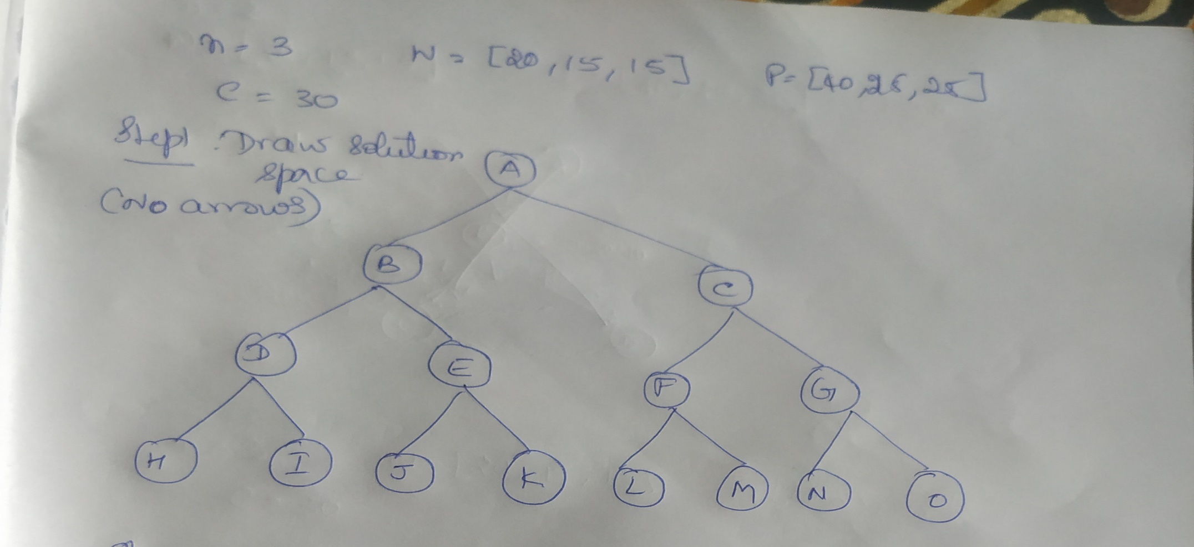
0/1 knapsack- backtracking without bounding function
Consider the knapsack instance n = 3, w = [20, 15,15], p = [40, 25, 25], and c = 30

Slide 12
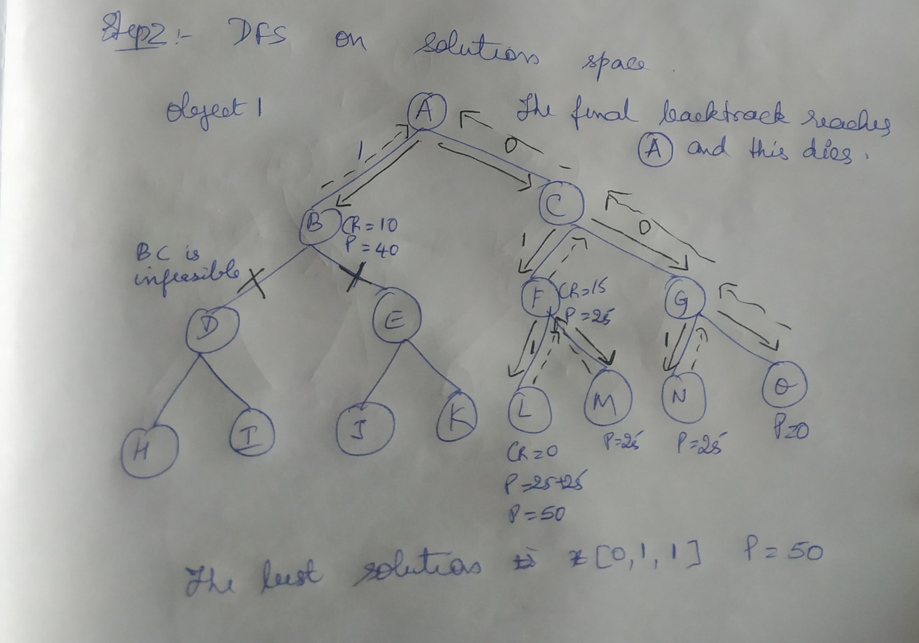

Slide 13
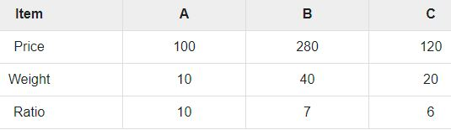
Example 2
Capacity=60

Slide 14
Capacity =60

Slide 15
A more effective way is to order the remaining objects by profit density (pi/wi), fill the remaining capacity by putting in objects in decreasing order of density, and use a fraction of the first such object that doesn’t fit.
Consider the instance n = 4, c = 7, p = [9, 10, 7, 4], and w = [3, 5, 2, 1]. The profit densities of these objects are [3, 2, 3.5, 4].
Object 4, object 3, object 1 and object 2

Slide 16
Object 4, object 3, object 1 and object 2

Slide 17
Solution space is a tree and has 2 ^{n} leaf nodes and 2^{n+1} − 1 total nodes.
As a result, every algorithm that moves through all nodes in the tree must spend Ω(2^{n}) time.

Slide 18
Can we speed the search? YES
We can speed the search for an optimal solution by determining whether or not a newly reached node can possibly lead to a solution better than the best found so far.
If it cannot, then there is no point moving into any of its subtrees and the node may be immediately killed.
Strategies that are used to kill live nodes are called bounding Functions

Slide 19
p = [9, 10, 7, 4], and w = [3, 5, 2, 1]. The profit densities of these objects are [3, 2, 3.5, 4].
Object 4, object 3, object 1 and object 2
When the knapsack is packed in decreasing order of profit density, object 4 is packed first, then object 3 is packed, and then object 1.
Following the packing of these three objects, the available capacity is 1.
This capacity is adequate for 0.2 of object 2. Putting in 0.2 of this object yields a profit of 2.

Slide 20
The solution constructed is x = [1, 0.2, 1, 1], and the corresponding profit is 22.
Although this solution is infeasible (x2 is 0.2 while it should be either 0 or 1), its value 22 can be shown to be no less than the best feasible solution.
Therefore, we know that the 0/1 knapsack instance has no solution with value more than 22.

Slide 21
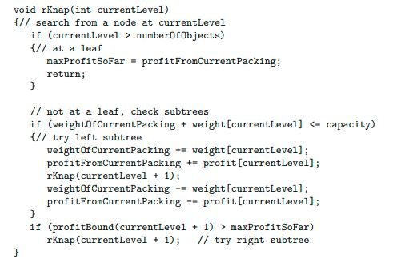

Slide 22
Bounding function for 0/1 knapsack is as follows:
At a node, If the current profit+ remaining profit< the best profit so far, then don’t explore its right branch.

Slide 23
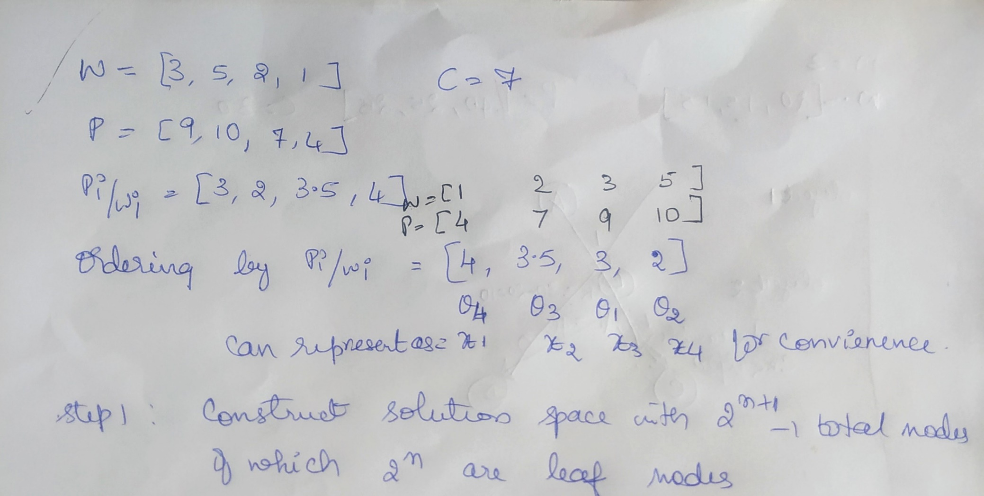

Slide 24
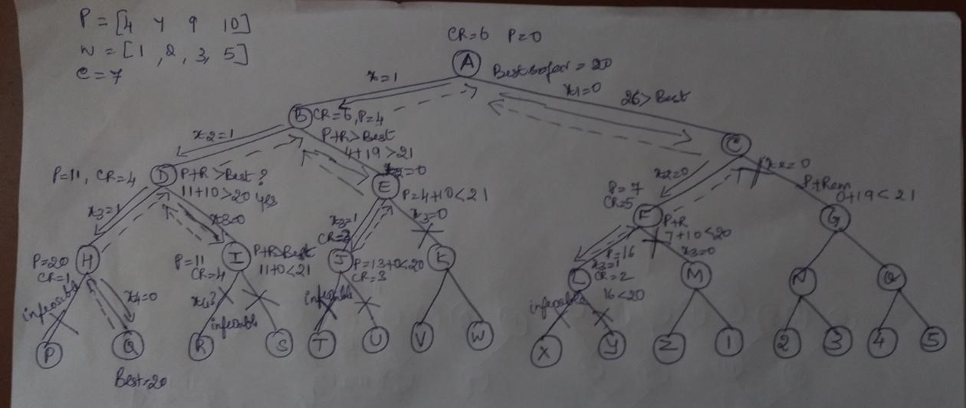

Slide 25
Ex2:
N=4 c=21
P=[10, 20,30,15]
W=[2,10,10,1]
Pi/wi=[5,2,3,15]
Ascending order of pi/wi
P=[15,10,30,20] and w=[1,2,10,10]
x1=obj4, x2=obj 1, x3=obj3 and x4=obj2

Slide 26
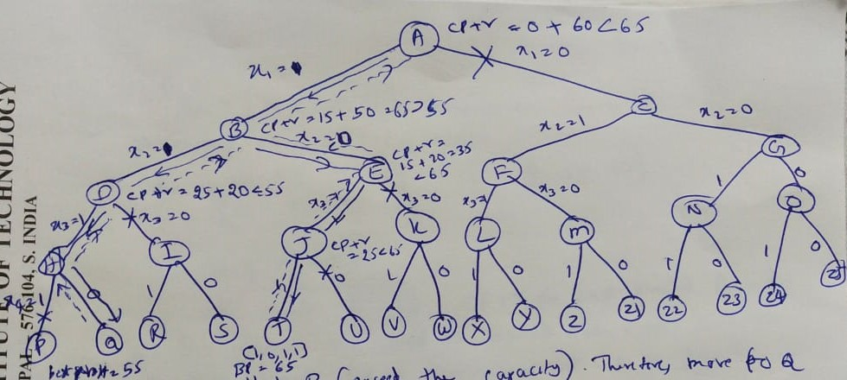

Slide 27
student workout: C=60

Slide 28
In a nutshell…
The steps involved in the backtracking method are
1. Define a solution space that includes the answer to the problem instance.
2. Organize this space in a manner suitable for search.
3. Search the space in a depth-first manner using bounding functions to avoid moving into subspaces that cannot possibly lead to the answer.

